Slide 1
GPU CLUSTERING AND MULTI- TENANT UTILIZATION TOOL
PROFESSOR:
DR.VAHID BEHZADAN ADVISOR:
ASHISH AGARWAL
TEAM MEMBERS:
CHANDU.GOGINENI
PAVAN TEJA.SRIPATI
KEERTHI.KASARANENI
SNEHA.VANGALA

Slide 2
CONTENTS:
Project Overview
Key Features
Introduction
Prerequisites
System Architecture Diagram
Deployment Steps
Kubernetes Cluster Setup
JupyterHub Interface
Access and Management
Troubleshooting & Maintenance
Challenges
Benefits
Project Outcomes
conclusion

Slide 3
PROJECT OVERVIEW:
Objective:
Set up a Kubernetes-based GPU cluster for efficient multi-user resource sharing.
Use Case:
Facilitating collaborative research, data processing, and computational tasks in a multi-tenant environment.

Slide 4
KEY FEATURES:
Kubernetes Cluster Setup : Detailed steps for multi-GPU server configuration.
Jupyter Hub Integration : Multi-user access with dedicated GPU resource allocation.
GPU Resource Management : Optimized multi-tenant utilization using Helm and Kubernetes.
Networking & Security : Secure access with Kubernetes Dashboard and JupyterHub authentication.

Slide 5
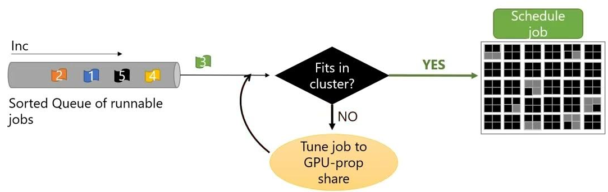
INTRODUCTION:
What is the Multi-Tenant GPU Cluster?
A Kubernetes-based system designed to optimize the utilization of GPU resources across multiple users.
Incorporates JupyterHub for seamless user management and resource allocation.
Why Multi-Tenancy?
Efficient sharing of expensive GPU resources.
Supports collaborative environments for research, data processing, and machine learning.

Slide 6
PREREQUISITES:
Linux System : Ubuntu 24.01+ recommended.
Software Tools : Docker, Kubectl, Kubeadm, and Helm installed.
Hardware: Servers with multiple GPUs for deployment.

Slide 7
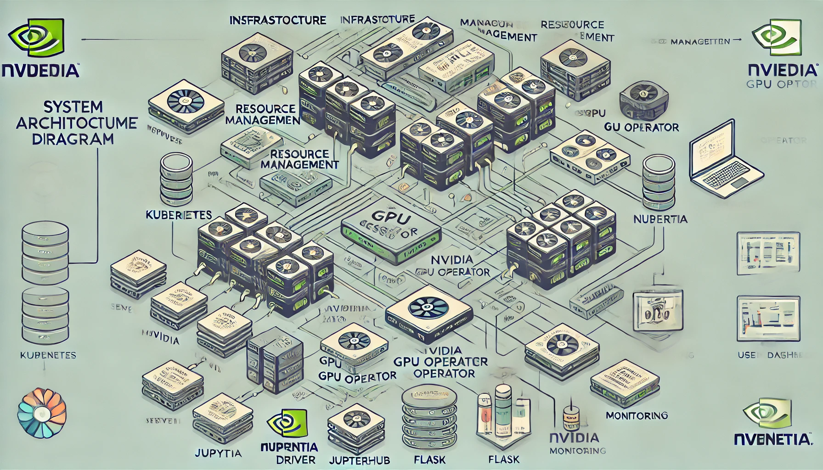
SYSTEM ARCHITECTURE DIAGRAM:

Slide 8
DEPLOYMENT STEPS
Initialize Kubernetes Cluster: kubeadm init --pod-network-cidr=192.168.0.0/16
Install Network Plugins: kubectl apply -f https://docs.projectcalico.org/manifests/calico.yaml
Deploy jupyterhub with helm: helm repo add jupyterhub https://jupyterhub.github.io/helm-chart/ , and helm upgrade --install jhub jupyterhub/jupyterhub -f config.yaml.

Slide 9
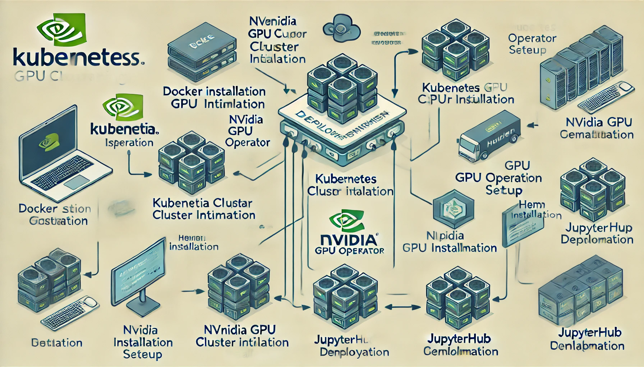
DEPLOYMENT STEPS:

Slide 10
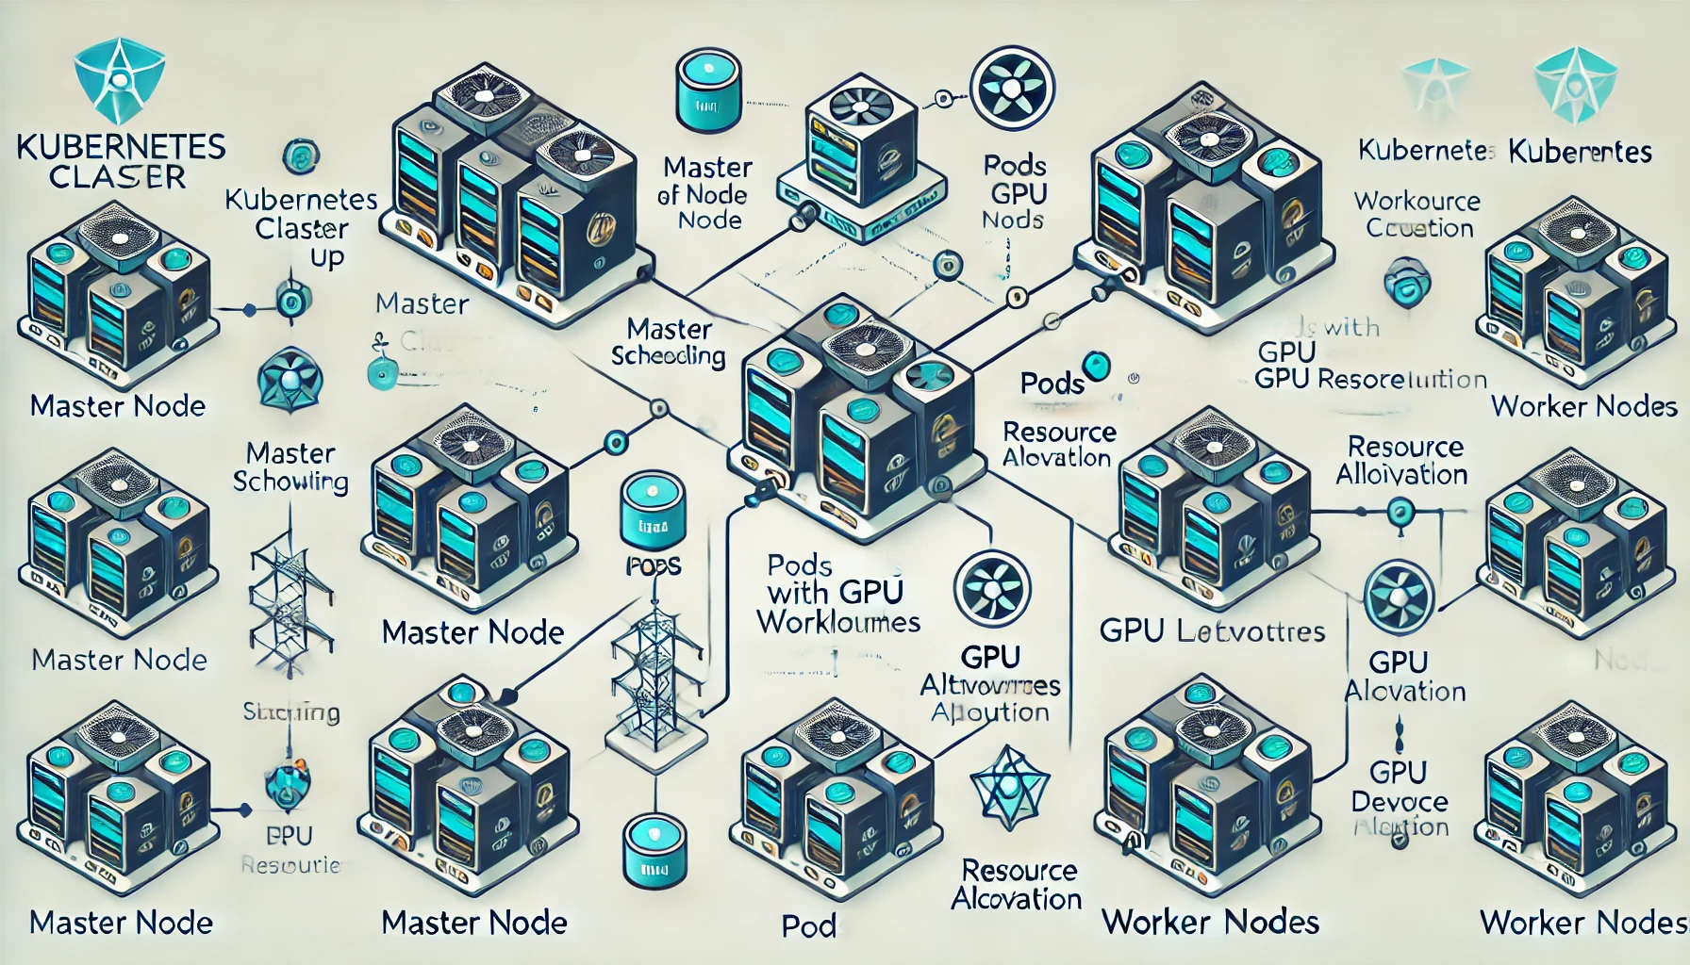
KUBERNETES CLUSTER SETUP:

Slide 11
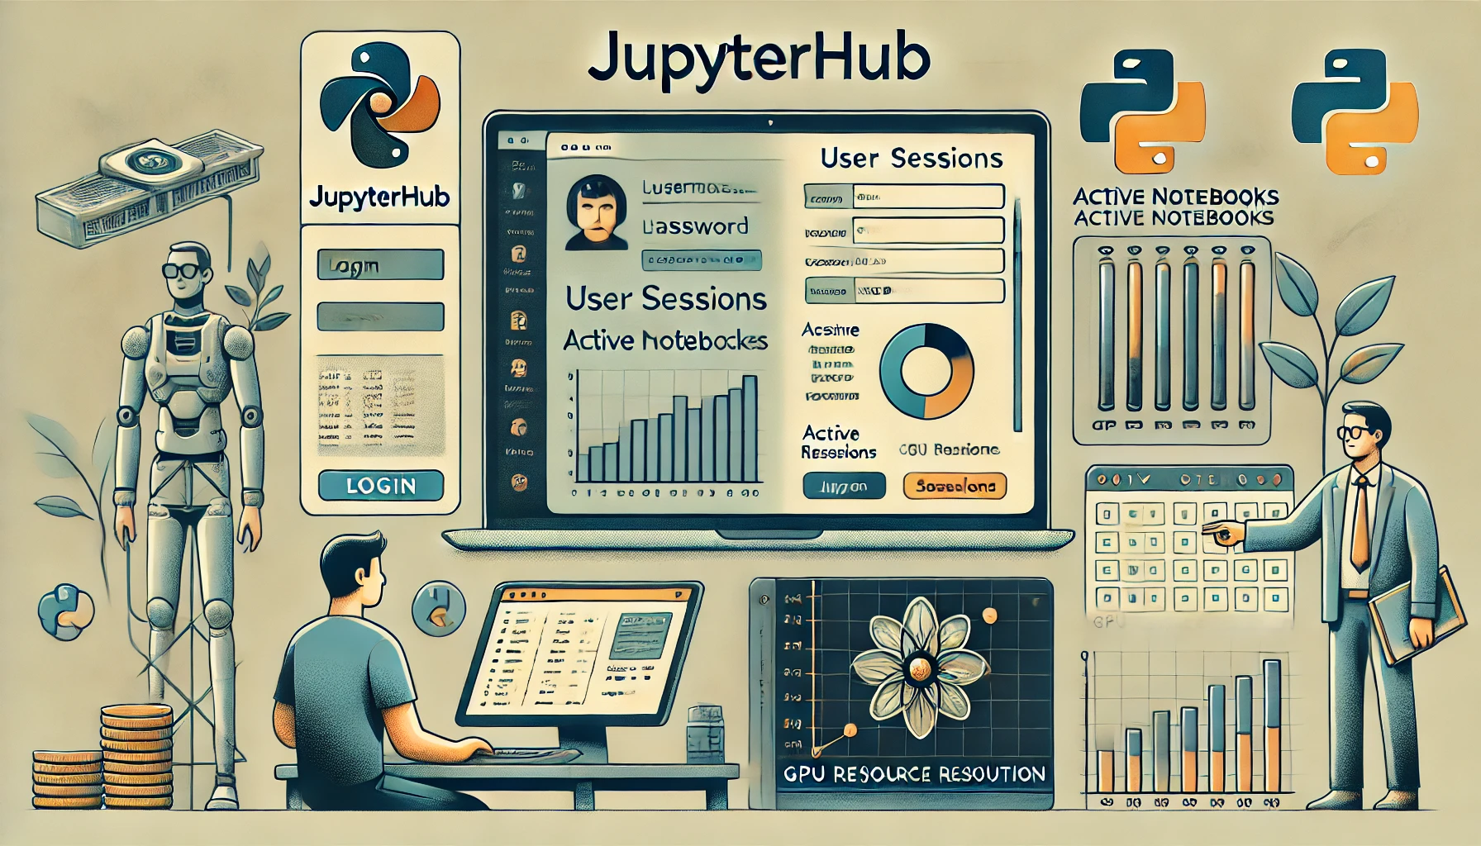
JUPYTERHUB INTERFACE:

Slide 12
ACCESS AND MANAGEMENT:
Kubernetes Dashboard: use kubectl port-forward for secure access. kubectl port-forward svc/kubernetes-dashboard -n kubernetes-dashboard 8001:443
JupyterHub:
Configure user resource limits for balanced GPU utilization.
Access via web interface.

Slide 13
TROUBLESHOOTING & MAINTENANCE:
Pod Scheduling Issues: kubectl describe pod <pod-name>
Networking Problems: kubectl get nodes -o wide
Logs for Debugging: kubectl logs <pod-name>

Slide 14
CHALLENGES
Throughout the development process, several challenges were encountered and resolved:
Compatibility Issues: Addressed software and hardware compatibility challenges by ensuring proper configuration of NVIDIA drivers, Kubernetes, and JupyterHub.
Resource Constraints: Optimized configurations for small-scale environments with limited GPU memory while maintaining scalability for larger setups.
Load Balancing and Quotas: Fine-tuned Kubernetes resource definitions to prevent resource over-allocation and ensure equitable distribution.

Slide 15
BENEFITS:
Efficient Resource Sharing: Optimized GPU utilization across users.
Scalability: Easily add nodes and GPUs to the cluster.
Security: Dedicated resource isolation per user.

Slide 16
PROJECT OUTCOMES
Enhanced Resource Utilization:
The tool dynamically allocates GPU resources across multiple users and workloads, maximizing efficiency and preventing under-utilization.
Intelligent scheduling mechanisms ensure fair distribution of resources, even during peak demand.
User Isolation and Security:
Secure role-based access control (RBAC) and Kubernetes namespaces provide user isolation, safeguarding workloads from interference.
Multi-tenancy ensures equitable access to GPUs while maintaining strict resource boundaries between users.
Scalable and Intuitive System Design:
Kubernetes serves as the backbone of the system, offering scalability, fault tolerance, and seamless load balancing for concurrent workloads.
JupyterHub integration enables an intuitive interface, familiar to users of platforms like Google Colab, ensuring ease of adoption by researchers, developers, and educators.

Slide 17
Real-Time Monitoring and Management:
GPU monitoring via NVIDIA plugins and integrated dashboards provides visibility into usage patterns, health metrics, and performance.
The system empowers administrators to proactively address issues, optimize resource allocation, and maintain cluster health.
Future-Ready Infrastructure:
Designed to be extensible, the tool can integrate advanced features such as AI-driven resource predictions, enhanced security policies, and cloud-based deployment for broader accessibility.

Slide 18
CONCLUSION:
Summary:
Multi-Tenant GPU Cluster simplifies managing GPU resources in a collaborative environment.
This project, GPU Clustering and Multi-Tenant Utilization Tool, effectively addresses the challenges of managing shared GPU resources in multi-tenant environments. By integrating Kubernetes, JupyterHub, and NVIDIA GPU monitoring, it achieves optimized resource utilization, scalability, and ease of access. The implemented tool provides a robust platform that meets the growing demands of GPU-intensive applications in research and development settings.

